Slide 1

// PROJECT LUNAR LANDER
Neuroevolutionary Precision Pilot
Training Neural Networks using Genetic Algorithms for Autonomous Landing

Slide 2

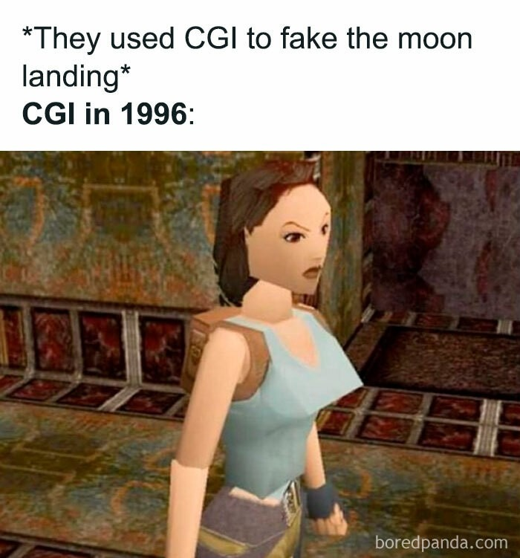
// THE CHALLENGE: LUNAR LANDING
The mission requires a software pilot to navigate a lunar module from the top center to a specific landing pad at coordinates (0,0) between two yellow flags.
Precision touchdown between flags
Minimal fuel consumption
Zero-crash safety tolerance

Slide 3
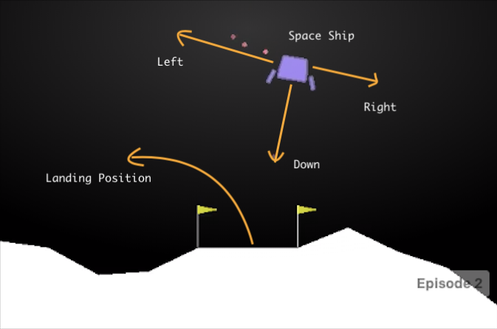

// GYMNASIUM ENVIRONMENT
LunarLander-v3
A classic rocket trajectory optimization problem. It uses Box2D physics to simulate gravity, momentum, and thrust interactions.
The agent must balance vertical descent and horizontal tilt simultaneously to avoid a catastrophic impact.

Slide 4
// WHAT THE PILOT SEES
Position
Orientation
Coordinates (X, Y) relative to the landing pad center.
Angle of the craft and its angular velocity (spin).
Velocity
Leg Contact
Linear velocity vectors in both horizontal and vertical axes.
Binary sensors for both left and right landing gear contact.

Slide 5
// CONTROLS & EXECUTION
2: Main Engine
Maximum thrust to counteract gravity and slow descent.
1: Left Thruster
3: Right Thruster
Fire side engine to rotate clockwise and move left.
Fire side engine to rotate counter-clockwise and move right.
0: Idle
Engines off. Saves fuel and allows for gravity-assisted descent.

Slide 6
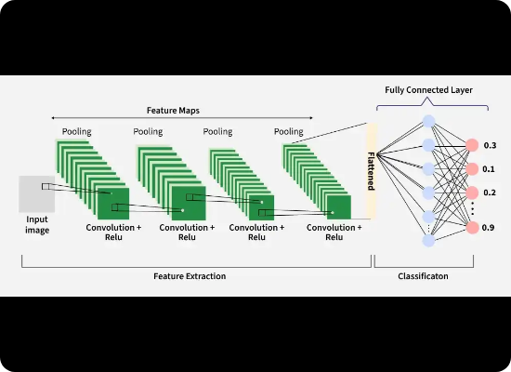
// THE BRAIN: ARCHITECTURE
MLP Structure: 8 → 64 → 32 → 4
A Multi-Layer Perceptron acts as the decision-making policy. It maps 8 sensory inputs directly to 4 action probabilities.
Activation: Tanh (Hidden), Argmax (Output)
Complexity: 2,724 Total Genes (Weights + Biases)
Inference: Fast matrix multiplication via NumPy

Slide 7
// METHODOLOGY: NEUROEVOLUTION
Genotype Encoding
Selection Process
Neural network weights are flattened into a single array (chromosome). We evolve the weights instead of using Gradient Descent.
Tournament Selection (K=6): Picks the strongest candidates from small groups to be parents of the next generation.
Two-Point Crossover
Top-6 Elitism
Preserves blocks of correlated weights, allowing for more stable trait inheritance compared to random shuffling.
Ensures that the best pilots are never lost, preserving progress across generations unconditionally.

Slide 8
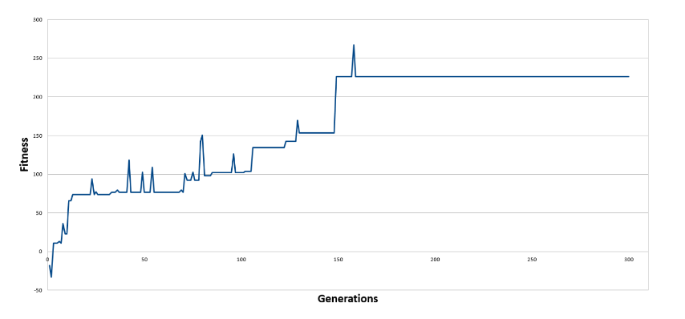
// TRAINING PROGRESS

Slide 9
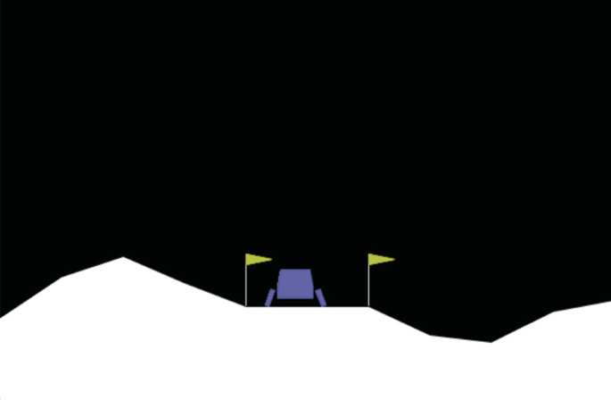
// REWARD SHAPING
Precision Bonus (+80): Fires when both legs touch. Incentivizes landing right on x=0 center.
Soft Landing Bonus (+40): Penalizes high vertical velocity. Teaches the agent to hover gently.
Upright Bonus (+30): Rewards landing at a perfect 0° angle. Eliminates side-scrapers.
Exploit Prevention: Removed "Touch-and-Go" hacks by averaging fitness over 5 random episodes.

Slide 10
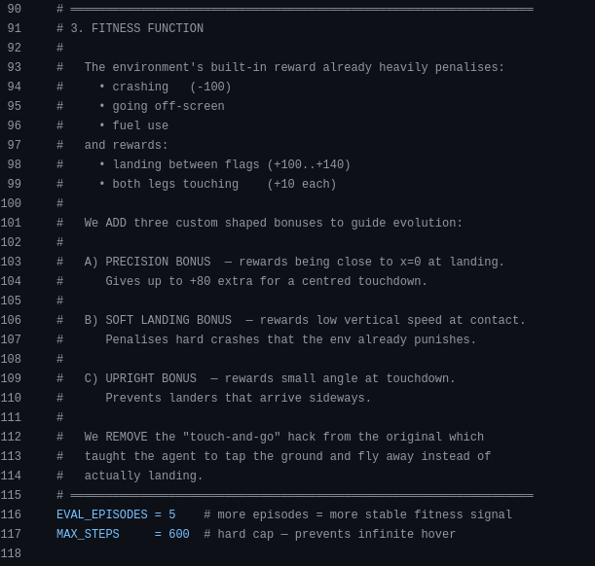
// ESCAPING LOCAL OPTIMA
Adaptive Mutation
Weak solutions mutate heavily (25%) to explore new strategies, while elite solutions mutate lightly (3%) to fine-tune successful traits.
STAGNATION LIMIT: 25
If fitness plateaus for 25 generations, mutation is boosted by 1.4x to "kick" the population out of the local optimum.

Slide 11
Safe Landing Achieved through Neuroevolution
Questions?

